Slide 1
Systematic Career Talks
Ramona Andreea Gherman
Senior Employer Branding Consultant

Slide 2


Slide 3






Systematic business areas
Defence
Healthcare
Digitalisation
Intelligence & National Security
Library & Learning
Renewables & Utilities
Operationally proven and world-leading C4ISR solutions for the modern battlespace.
Promoting the continuum of care through first-class healthcare IT.
Helping public and private enterprises with their digital transformation.
Solutions, services and know-how for surveillance, prevention, analysis, threat assessment and crisis handling.
The digital foundation for modern and ambitious libraries.
Green transformation solutions for the offshore wind energy and water supply sectors.
Notes:
Over the years, we have become increasingly specialised in the areas to which we deliver our products.
Our IT solutions are used in defence, by the police, in hospitals, in the care sector, at libraries, in the utility sector and in the financial sector. Critical functions in society depend on our IT systems, which inspires and obliges us to continually develop and improve our business, our employees and our products. We have soldiers, nurses, social service workers and librarians employed as specialists. They know the users, their work routines, technical jargon and needs. They know what is required to overcome sector-specific challenges.
DEF: Command and control, Situational awareness, Interoperability, Electronic warfare HC: Electronic medical record, Patient and service flow, Community care record, Telemedicine DT: The public sector, The finance sector, Logistics and transport, Agriculture Security: Classified solutions, Cyber security, Control room and mobility, Preparedness management LL: Libraries, Joint Library System, Educational solutions, Educational institutions Renewables: The energy sector, Wind farm solution, Water energy solution

Slide 4

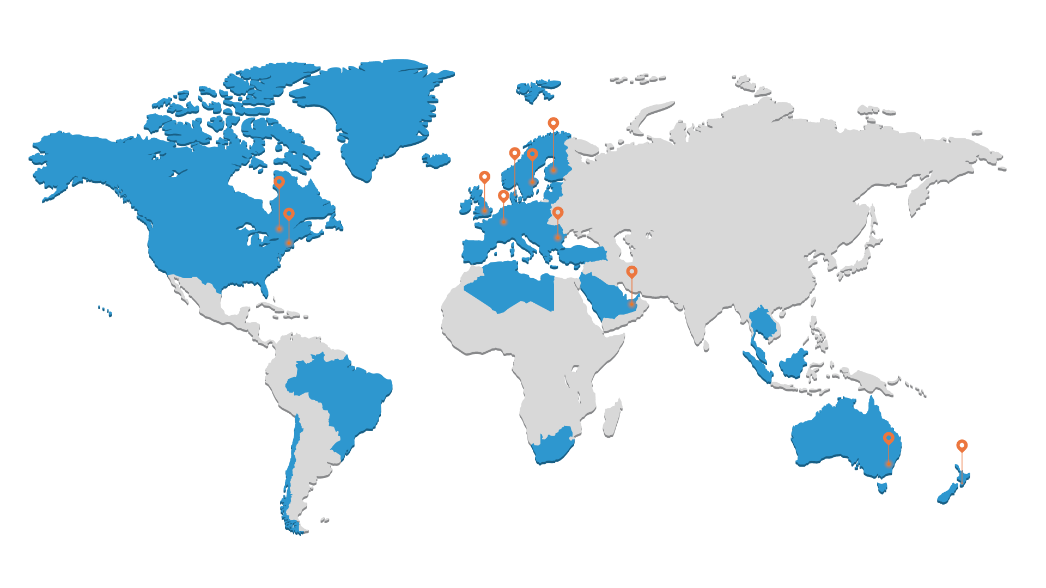



Where can you find us
13 offices in 11 countries
1,000+ employees
1m+ users across 50 countries
Systematic Bucharest office is placed
at P-ta Romana
Notes:
Systematic is continually striving to make a positive difference to society. Our contribution consists of exceptional software that creates more opportunities and better lives for everyone. This is what we do and what 1,100 employees in 11 countries take pride in doing through their commitment and attention to detail.

Slide 5
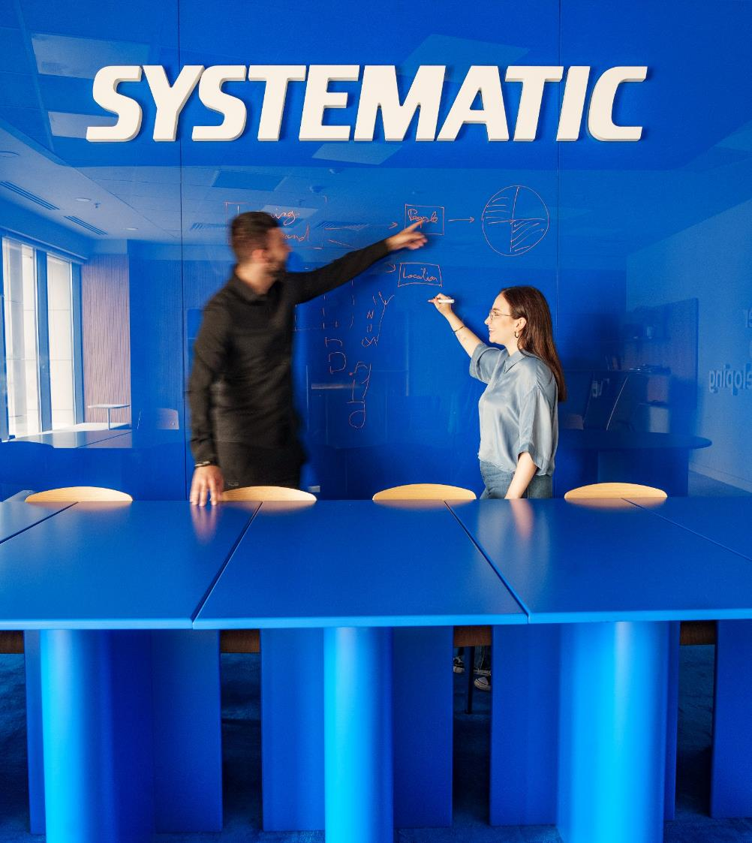
Employees in numbers
Number of certifications
Java Scrum Prince2
ITIL
Oracle PMP
Other
97
215
161
62
21
24
345
0 50 100 150 200 250 300 350
400
Educational profile of Systematic’s employees
(as of 27 February 2024)
29,4%
of the employees in Systematic are women
Notes:
People are the single most important part of Systematic. We are a uniquely social company, and we sincerely enjoy spending time together. Professionally and personally.

Slide 6
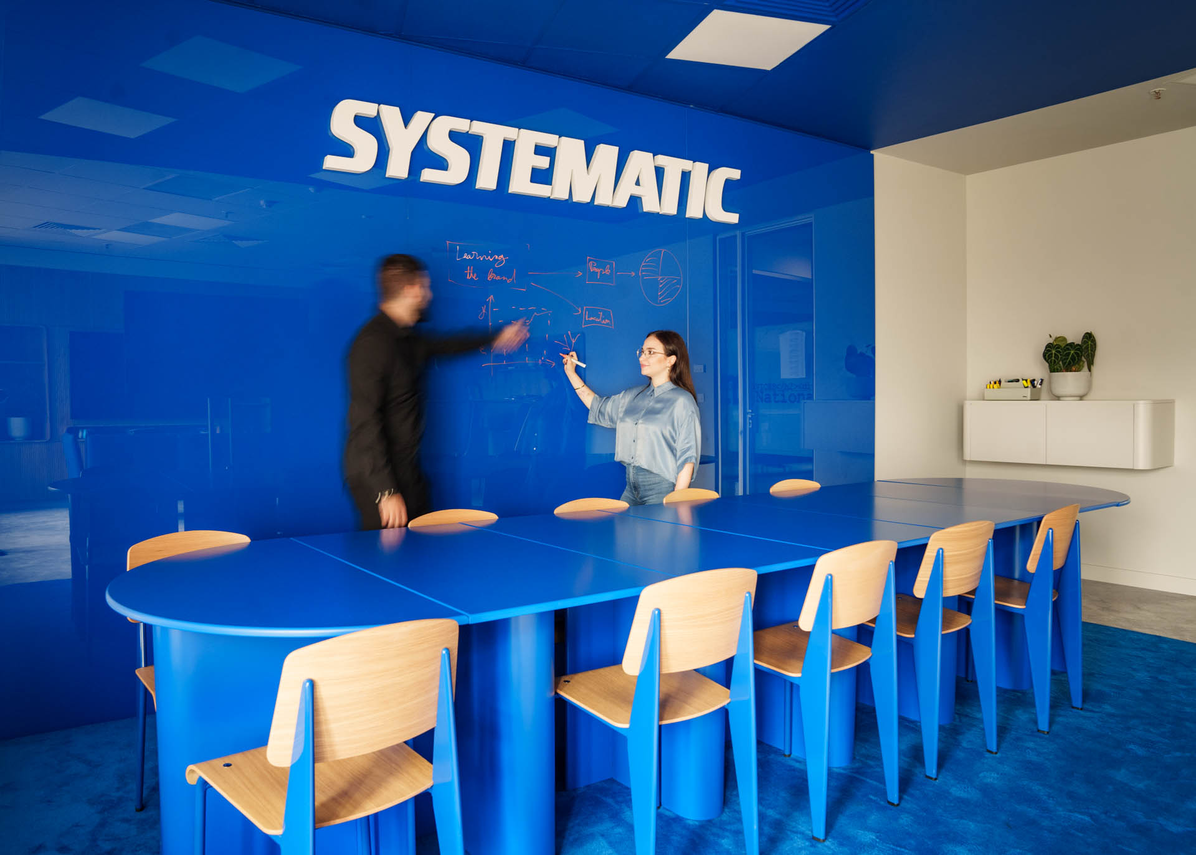
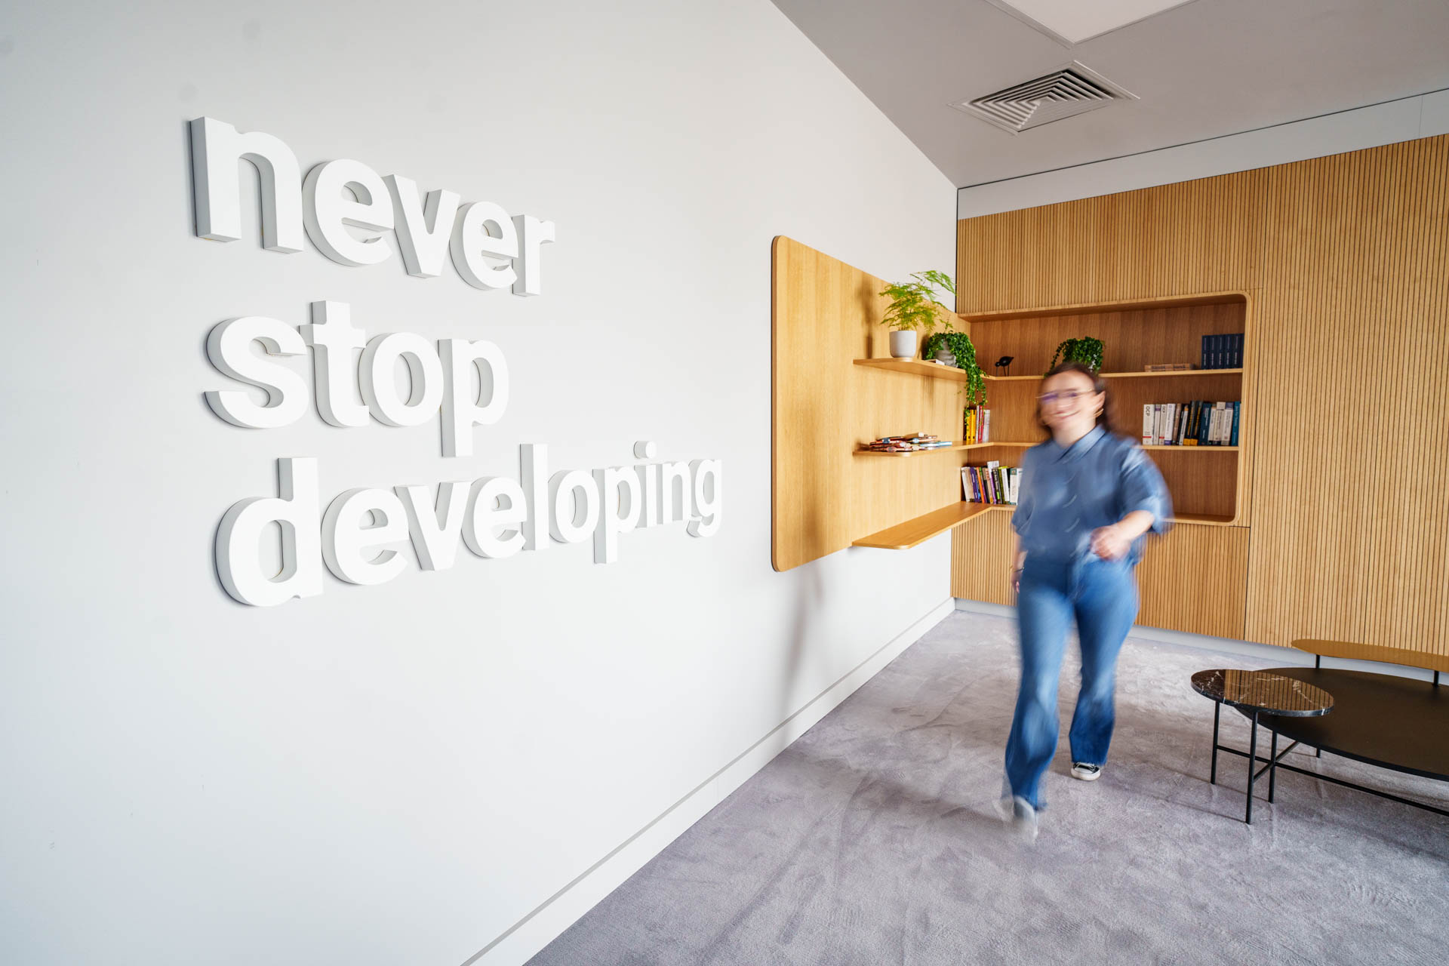
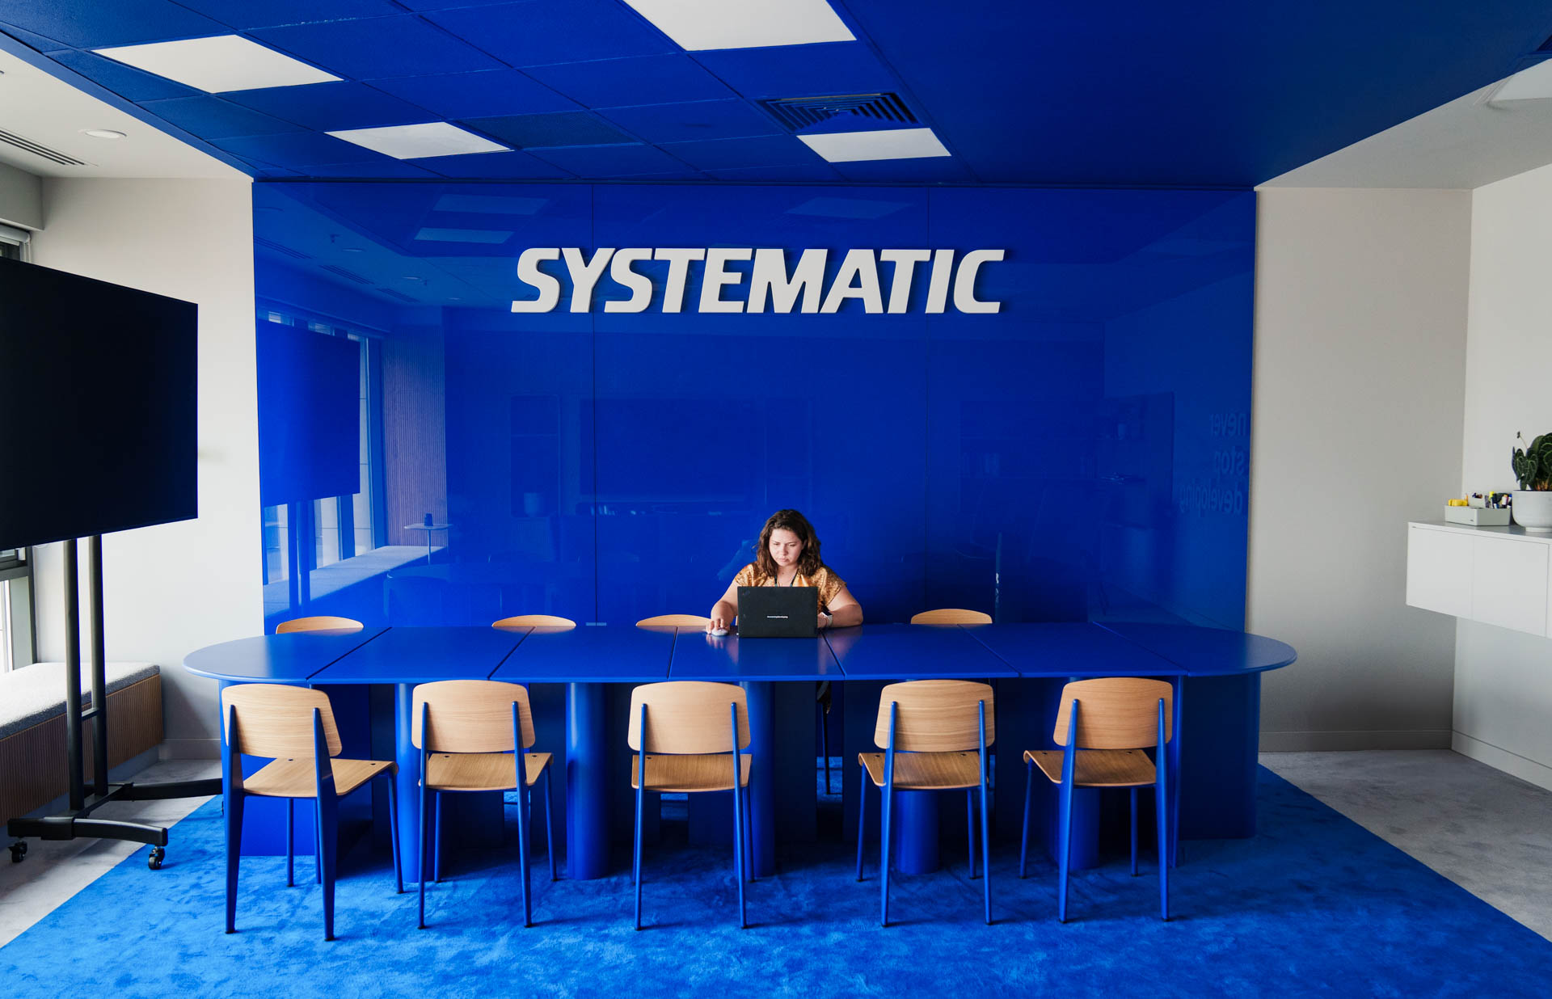
Where?
Systematic office, Landmark , Piata Romana

Slide 7

Scan & find out more about the Internship program at Systematic!

Slide 8




Building Better Estimates: Insights with Spring Boot, Angular & Docker
Andrei Ghideu - Senior Software Developer
Sofia Ioana Pascu - Software Developer
Marian Gabriel Alexandrescu - Software Developer
Notes:
Introducerea noastra:
Experienta internship-ului, mx estimates si Systematic
Experienta mentoratului, experienta Systematic

Slide 9


Internship
experience

Slide 10


Slide 11
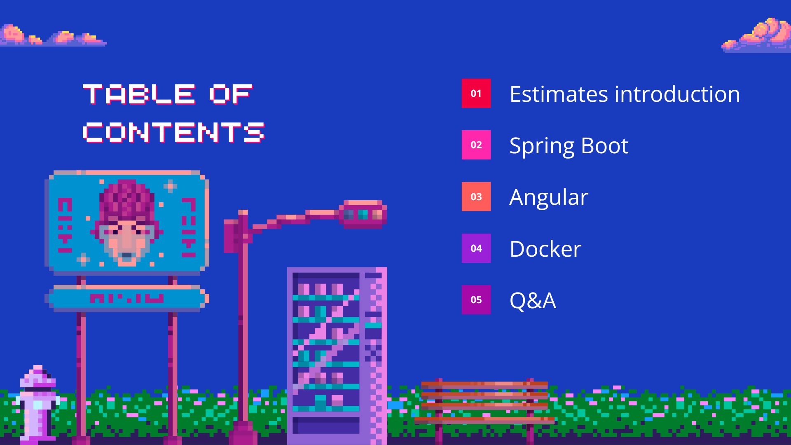
Internship
experience

Slide 12



Slide 13
Prevents project delays and failures
Improves planning and resource allocation
Accurate estimation sets realistic expectations
Improves decision making and risk management
WHY
ESTIMATES?
Notes:
Explicare context si business logic

Slide 14
Makes software development more predictable and efficient
Essential for Agile and Scrum methodologies
Checklist can be used to improve accuracy
Story points, T-shirt size and Three-point estimation techniques
WHY
ESTIMATES?
Notes:
Explicare context si business logic

Slide 15
Optimistic - shortest time if everything goes fine (realistic)
Predicts how long a project will take by considering best-case, worst-case and most likely scenarios
Most likely – expected time based on past experience
Pessimistic – longest time if issues and blockers apepear
THREE
POINT
ESTIMATION

Slide 16
MVP – Most Valuable Product
Story – Development task from MVP
Feature lead – person that is responsible for the feature
Feature – New functionality added to application
TERMINOLOGY USED

Slide 17
Aplicatie orare
Generarea aplicatiei
Interfata vizuala
Implementarea baze de date
Implementare backend
Generare orare pe baza AI
Antrenarea AI-ului
Integrarea in aplicatie
Notes:
Slide gol dar il vom complete cu ei:
Vor allege o tema (va fi titlu)
Pe baza temei, vom crea doua mvp-uri, le vom trece mai jos si pe acelea; ne vom gandi si la cateva story-uri, impreuna cu ei

Slide 18
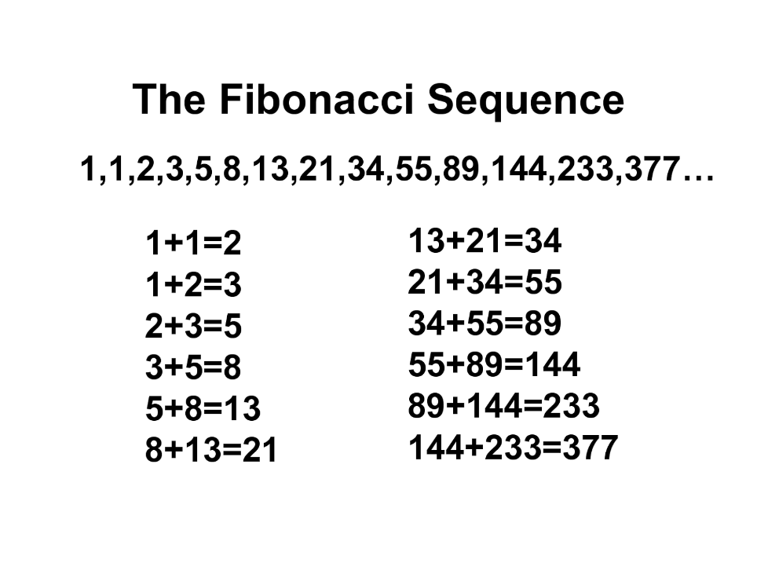
POKER PLANNING Interfata vizuala
Notes:
Poker planning pentru un story din oricare mvp

Slide 19
POKER PLANNING SESSION 2
Notes:
Poker planning pentru alt story

Slide 20

Angular 15
Spring Boot 3
Docker
Postgres

Slide 21
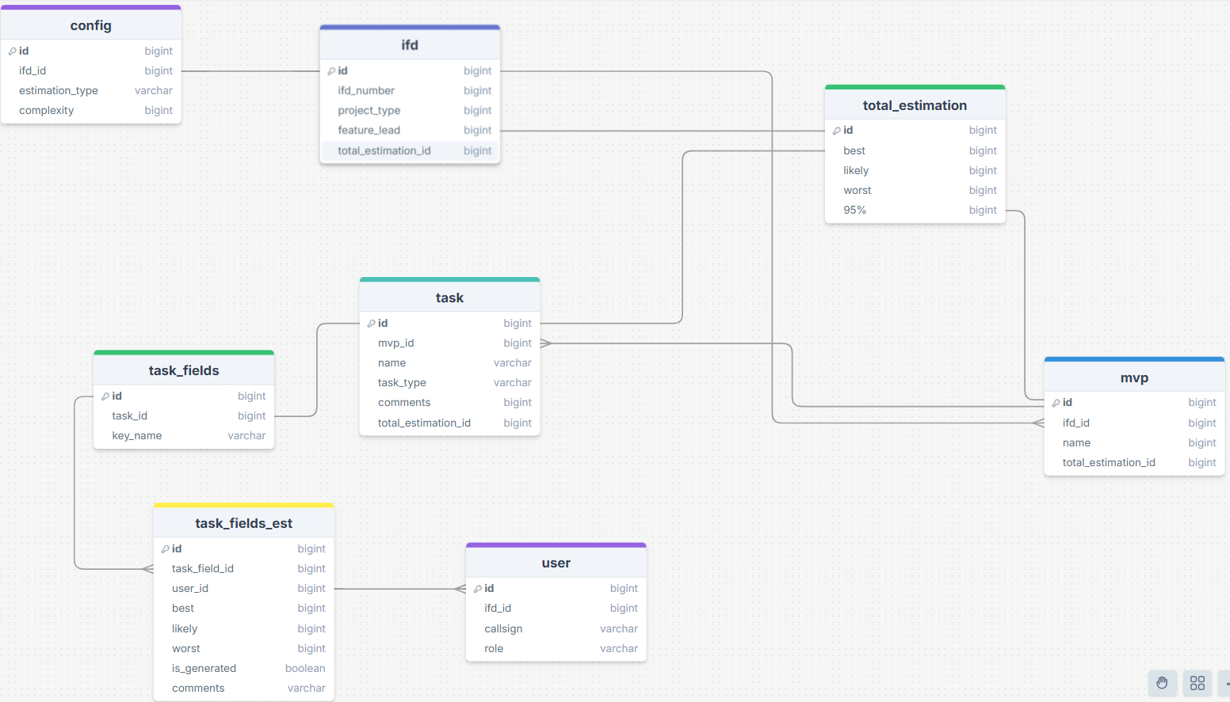
Database diagram

Slide 22


Slide 23






WHAT IS SPRING BOOT?
SPRING BOOT
Is a framework that makes it easy to create stand-alone, production-grade Spring based Applications that you can "just run".
PLATFORM
With the Spring platform and third-party libraries, you can get started with minimum fuss. Most Spring Boot applications need minimal configuration.
INITIALIZE
Spring initializr facilitates app development with only a few clicks. Try it out https://start.spring.io/.

Slide 24
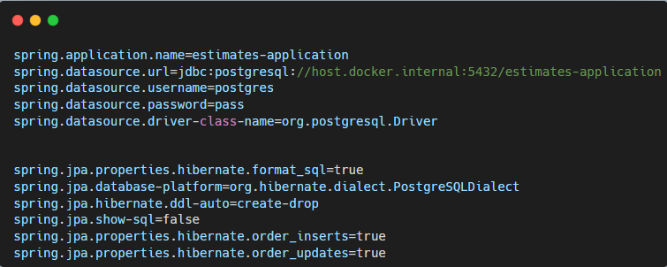
Application properties

Slide 25
Models (beans) and Repositories.
Controllers.
Services.
For this demo you will find

Slide 26
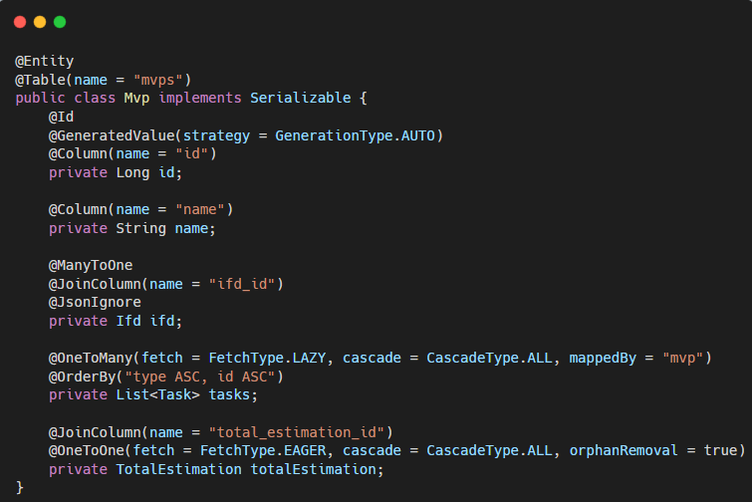
BEAN

Slide 27



SPRING DATA
INTERFACING
Spring Data simplifies database access in Spring applications, especially those using JPA, by reducing the amount of required code.
In Spring Data, each domain entity has a repository interface that includes methods for sorting, paginating, and CRUD operations. The @Repository annotation marks the interface as a repository.
@REPOSITORY
EXTENSION
A repository is created by extending particular repository interfaces like CrudRepository, PagingOrSorting Repository, or JPARepository.

Slide 28
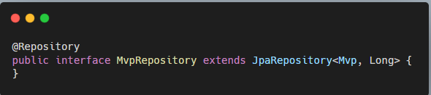
REPOSITORY

Slide 29




SPRING BOOT - @CONTROLLER
MEDIATE
CONVERSION
Intercepting incoming https requests.
Converting the payload of the request to the internal structure of the data.
FEATURES
CONNECTION
PROCESS
Sending the data to Model for further processing.
Getting processed data from the Model and advancing that data to the View for rendering.

Slide 30
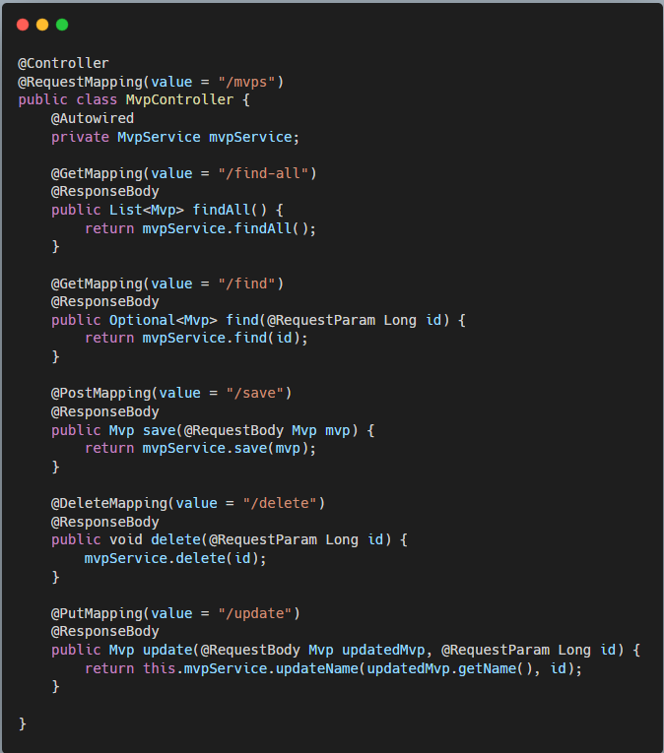
CONTROLLER

Slide 31
SPRING BOOT - @SERVICE
CONCEPT
Service Components are the class file which contains @Service annotation.
USAGE
These class files are used to write business logic in a different layer, separated from @RestController class file.

Slide 32
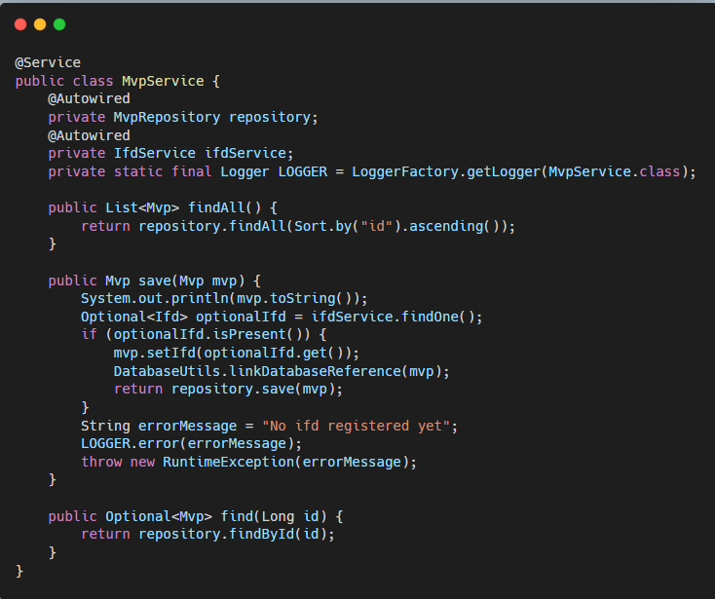
SERVICE

Slide 33
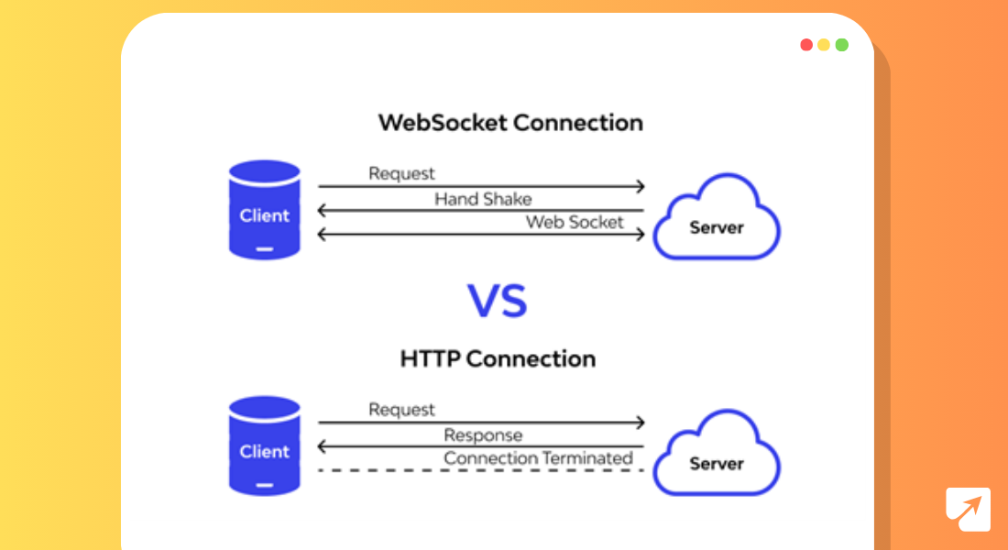
WebSocket connection

Slide 34
Simple Text Oriented Message protocol
Built on top of WebSockets, adding a messaging format and using simple commands to communicate
Allows real-time communication between clients and servers
Often used in chat apps, notifications and live data streaming
STOMP protocol

Slide 35
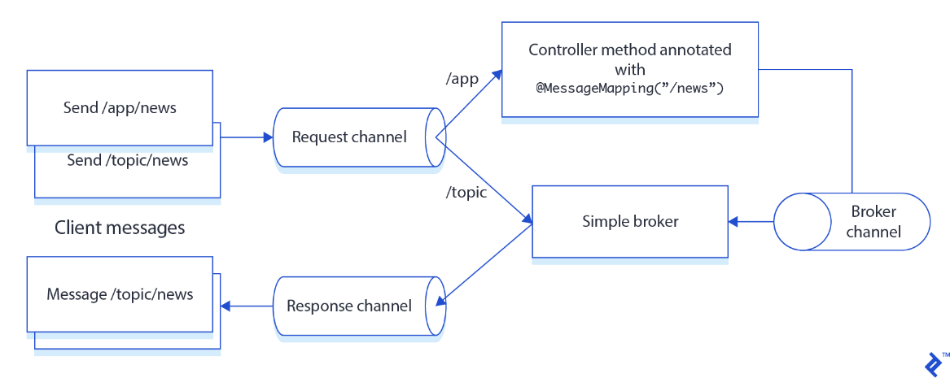
STOMP protocol
A client sends a message to either /app/news or /topic/news.
The request channel forwards the message to a controller method (@MessageMapping("/news")) or sends it directly to broker
The controller processes the message and publishes it to /topic/news.
The simple broker receives the message and distributes it via the broker channel.
Any clients subscribed to /topic/news receive the message through the response channel.

Slide 36


Slide 38
THE MAIN BUILDING BLOCK OF AN ANGULAR APPLICATION IS THE COMPONENT, USED TO CREATE UI COMPONENTS

Slide 39

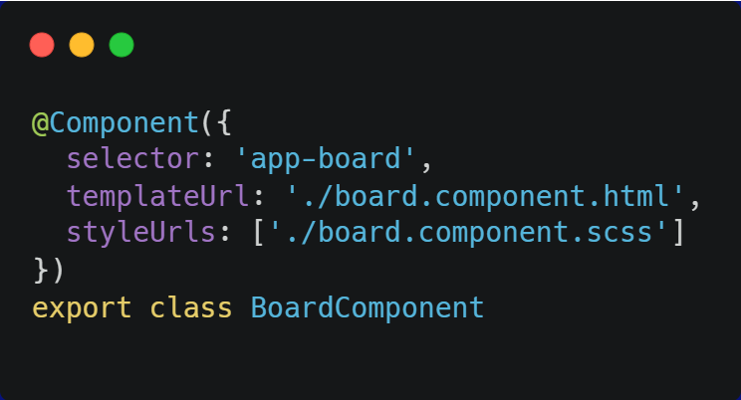


HTML Selector
COMPONENT
STRUCTURE
HTML Template
Stylesheet
MENTORING IN CONFIDENCE
39

Slide 40


Defined by a special decorator which holds metadata
COMPONENT
STRUCTURE
Contains inputs, outputs, properties, methods
MENTORING IN CONFIDENCE
40

Slide 41
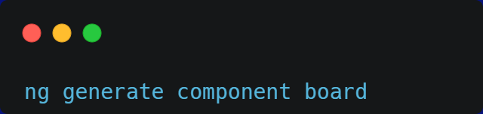
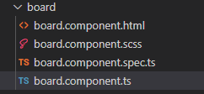
YOU CAN CREATE COMPONENTS DYNAMICALLY USING THE ANGULAR CLI

Slide 42
HTML file (referenced in the component) or snippet (inline template)
Every component has a template
Defines the DOM of the component
WHAT IS AN ANGULAR TEMPLATE?
MENTORING IN CONFIDENCE
42
Notes:
Din albastru in alb

Slide 43
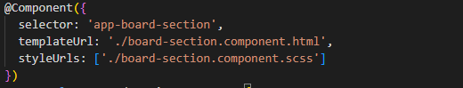
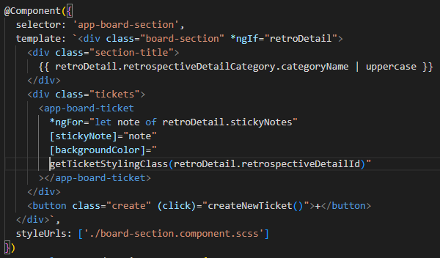
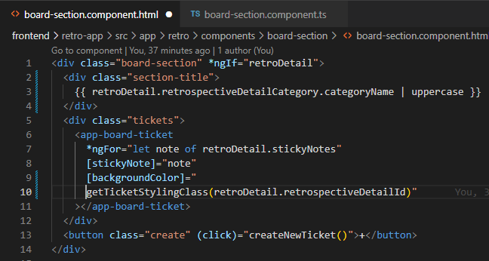
EXTERNAL VS INLINE TEMPLATES

Slide 44

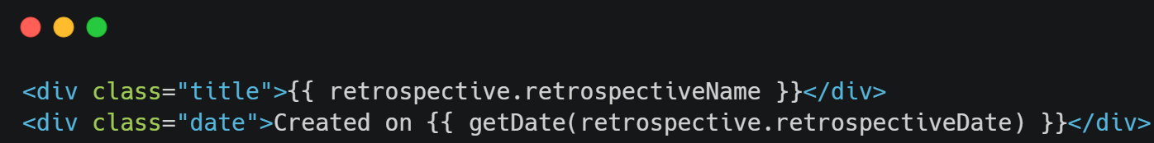
You can use component properties or call methods within the template
DYNAMIC DATA IN TEMPLATES
MENTORING IN CONFIDENCE
44

Slide 45

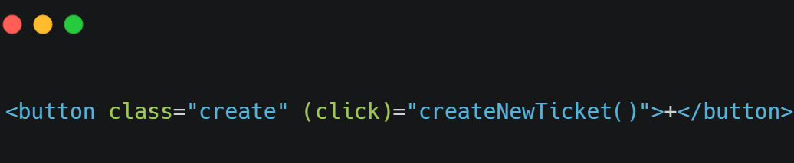
Methods that can be used to respond to events
TEMPLATE STATEMENTS
MENTORING IN CONFIDENCE
45

Slide 46
Class that extends the behavior of components
Does not have a template
Can manipulate the DOM, apply styles, handle events
WHAT IS A DIRECTIVE?
MENTORING IN CONFIDENCE
46

Slide 47
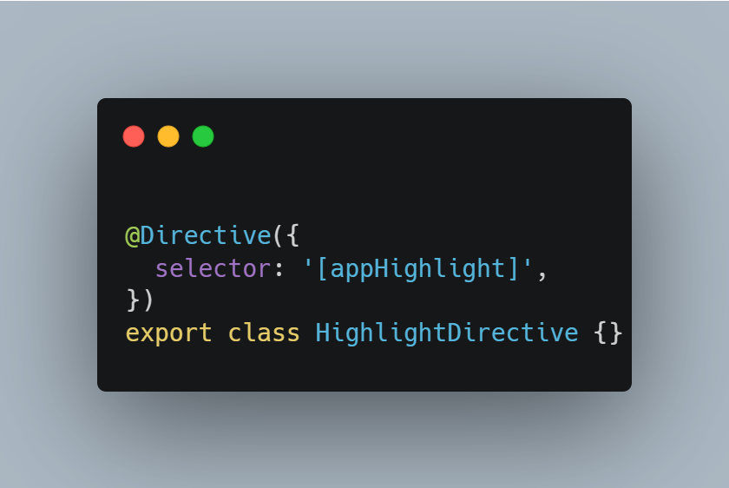
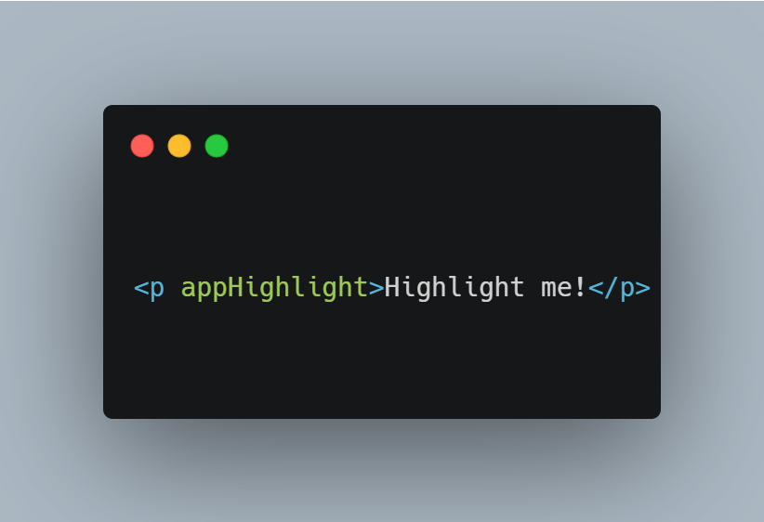
Defined by a special decorator which holds metadata
DIRECTIVE
STRUCTURE
MENTORING IN CONFIDENCE
47

Slide 48



Component directive: components are directives with templates
TYPES OF
DIRECTIVES
Structural directive: add, remove, or manipulate DOM elements
Attribute directive: change the appearance and behavior of elements
MENTORING IN CONFIDENCE
48

Slide 49


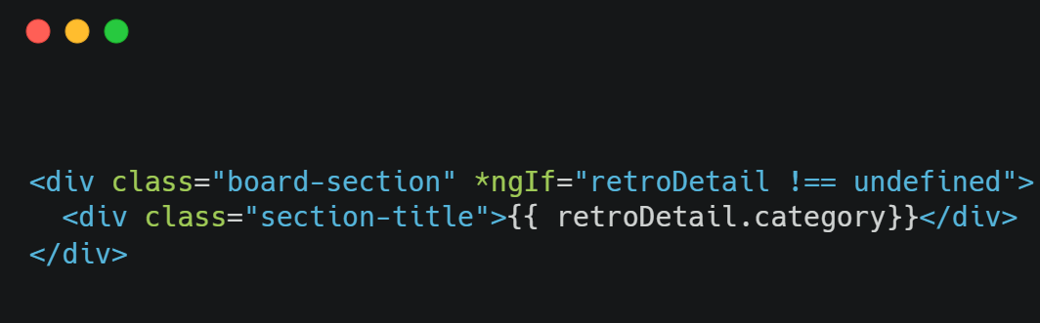
Structural directive
Used to show or hide content based on condition
ngIf
Controls whether an element will be rendered
MENTORING IN CONFIDENCE
49

Slide 50
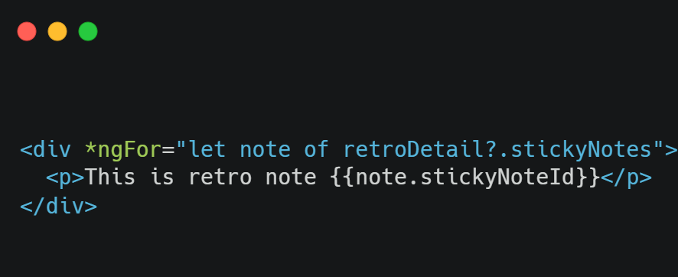
Structural directive
Renders a list of dynamic data
ngFor
MENTORING IN CONFIDENCE
50

Slide 51
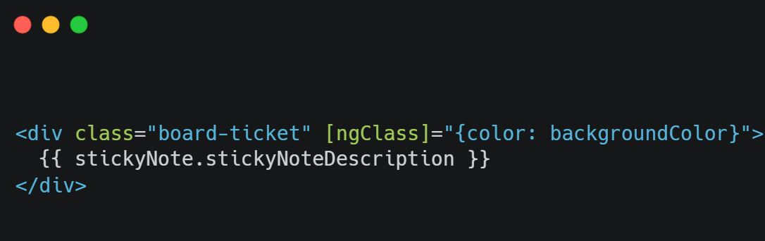
Attribute directive
Adds or removes CSS classes on HTML elements
ngClass
MENTORING IN CONFIDENCE
51

Slide 52
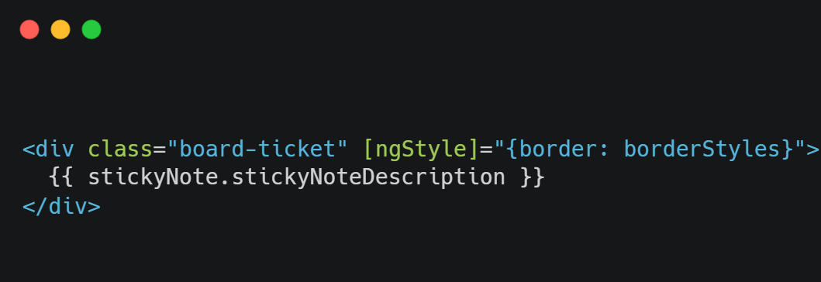
Attribute directive
Sets style properties to HTML elements
ngStyle
MENTORING IN CONFIDENCE
52

Slide 53
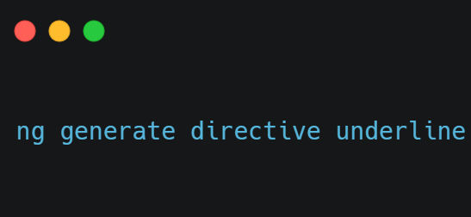
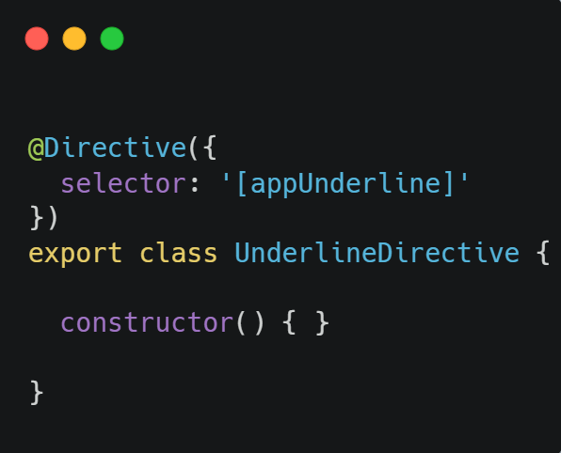
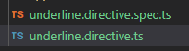
YOU CAN CREATE DIRECTIVES DYNAMICALLY USING THE ANGULAR CLI

Slide 54



A class decorated with the @Service decorator
WHAT IS A SERVICE?
Used to share logic between components
Treated as a single source of truth
MENTORING IN CONFIDENCE
54

Slide 55



Mechanism for delivering some parts of an app (services) to other parts (components, other services)
WHAT IS DEPENDENCY INJECTION?
Injector: instantiates the services in order to use them when needed
DI consumer <-> DI provider
MENTORING IN CONFIDENCE
55

Slide 56


DEPENDENCY INJECTION
PROVIDE THE DEPENDENCY
Add the @Injectable decorator to the service class
INJECT THE DEPENDENCY
By declaring it in the class which is going to use it
Notes:
Casute mai mici

Slide 57
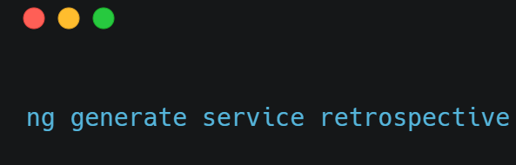
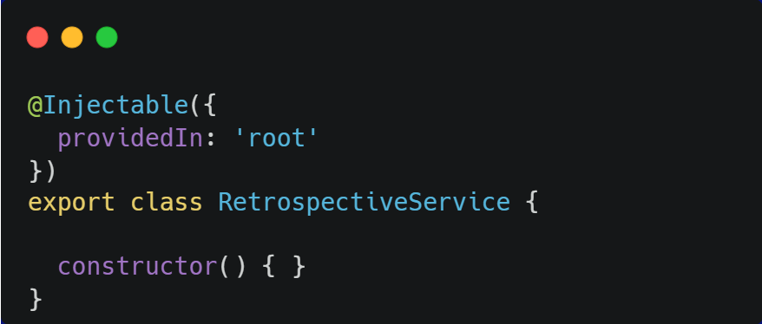
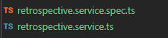
YOU CAN CREATE SERVICES DYNAMICALLY USING THE ANGULAR CLI

Slide 58
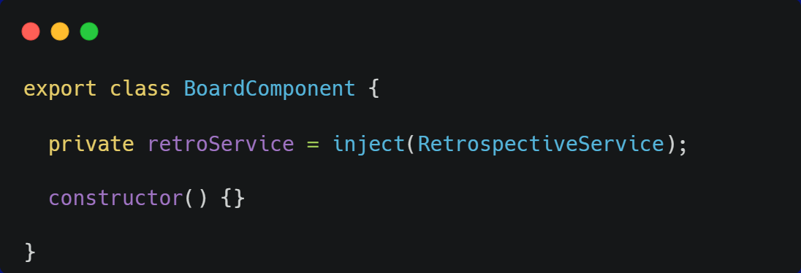

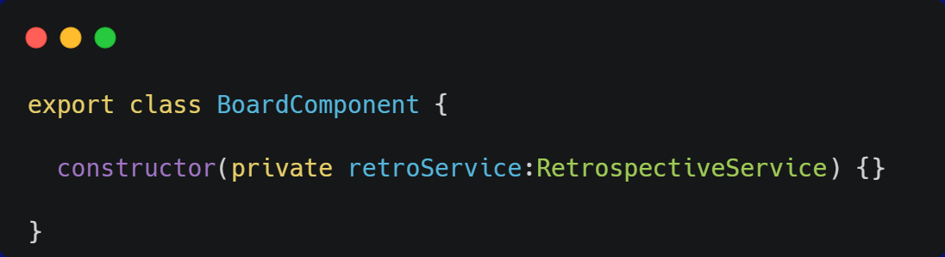
Using the inject method
INJECTING DEPENDENCIES
Using the constructor
MENTORING IN CONFIDENCE
58

Slide 59

At the root level
A single shared instance is received by all consumers
PROVIDING DEPENDENCIES
At the consumer level
A new instance is created for each consumer
MENTORING IN CONFIDENCE
59

Slide 60


The root module of any Angular application
AppModule
Used to bootstrap and launch the application
MENTORING IN CONFIDENCE
60
Notes:
Schimbat case

Slide 61
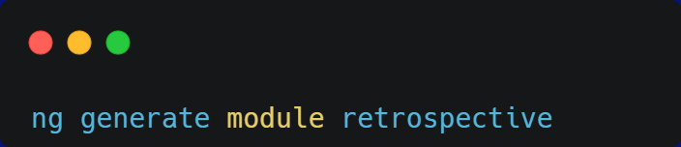
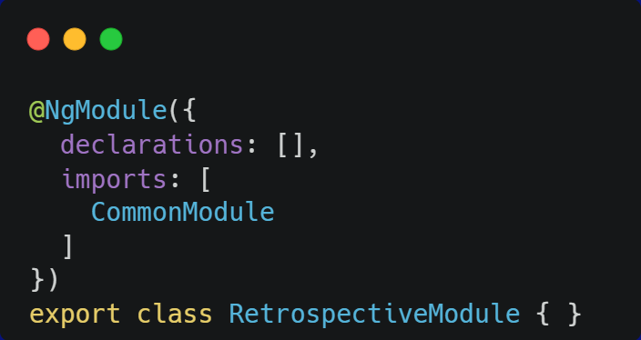
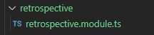
YOU CAN CREATE MODULES DYNAMICALLY USING THE ANGULAR CLI

Slide 62




WHAT IS A PIPE?
TRANSFORM
SIMPLE FUNCTIONS
Transform data to display (dates, currency amounts, strings)
Take the data and options as input values and output the result.
PIPE
USAGE
EXAMPLES
Usually used in templates, but can also be injected in component classes
DatePipe, UppercasePipe, CurrencyPipe

Slide 63
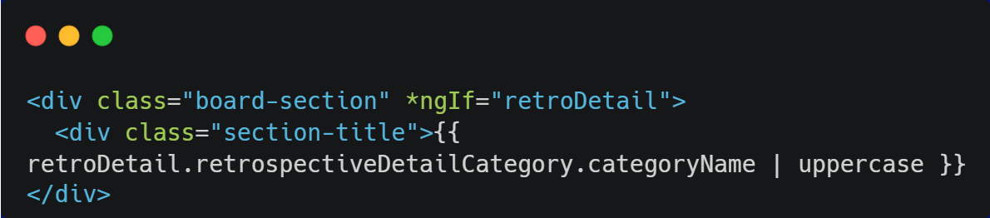
USING PIPES IN TEMPLATES

Slide 64
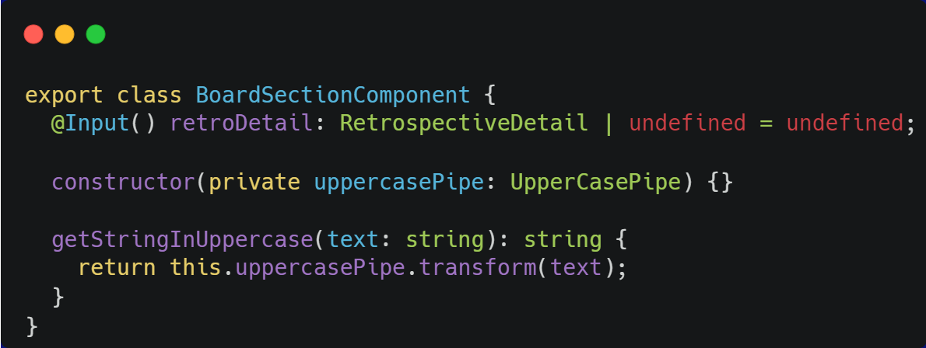
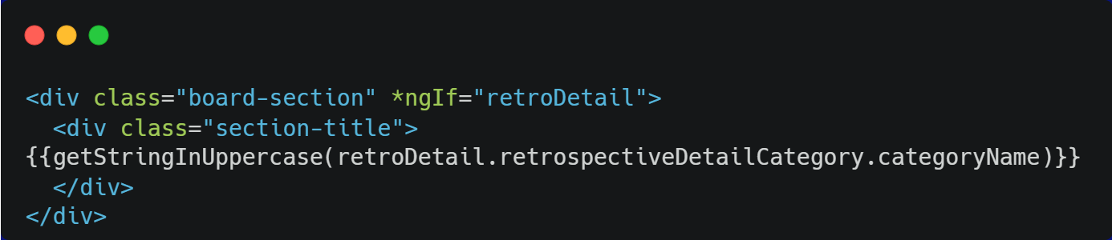
USING PIPES IN COMPONENT CLASSES

Slide 65

STEPS FOR CREATING A CUSTOM PIPE
CREATE THE TS CLASS
APPLY THE “@Pipe” DECORATOR
IMPLEMENT THE PipeTransform INTERFACE
DEFINE THE TRANSFORM METHOD

Slide 66




ANGULAR MATERIAL
RELIABLE
CUSTOMIZABLE
Component library developed by the Angular team
Contains a set of customizable components for Angular applications
EASY TO USE
RESPONSIVE
Can be used by installing the @angular/material NPM package to the project
Adapt easily to different screen sizes and devices

Slide 67
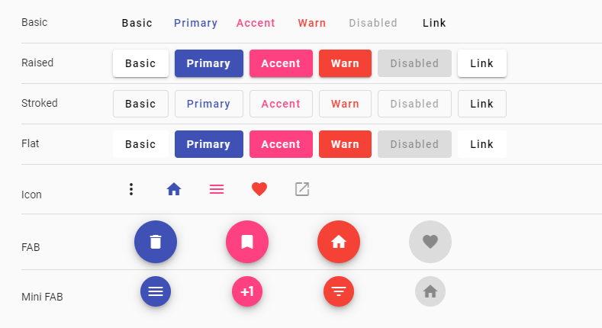
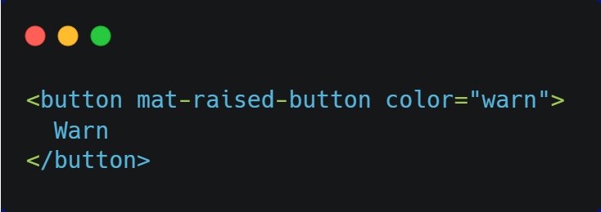
MATERIAL BUTTON

Slide 68
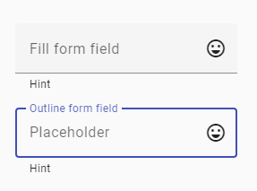
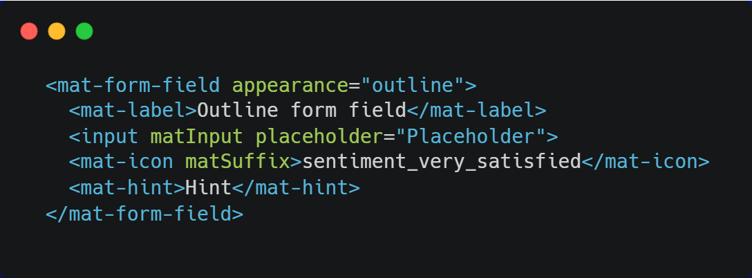
MATERIAL INPUT

Slide 69
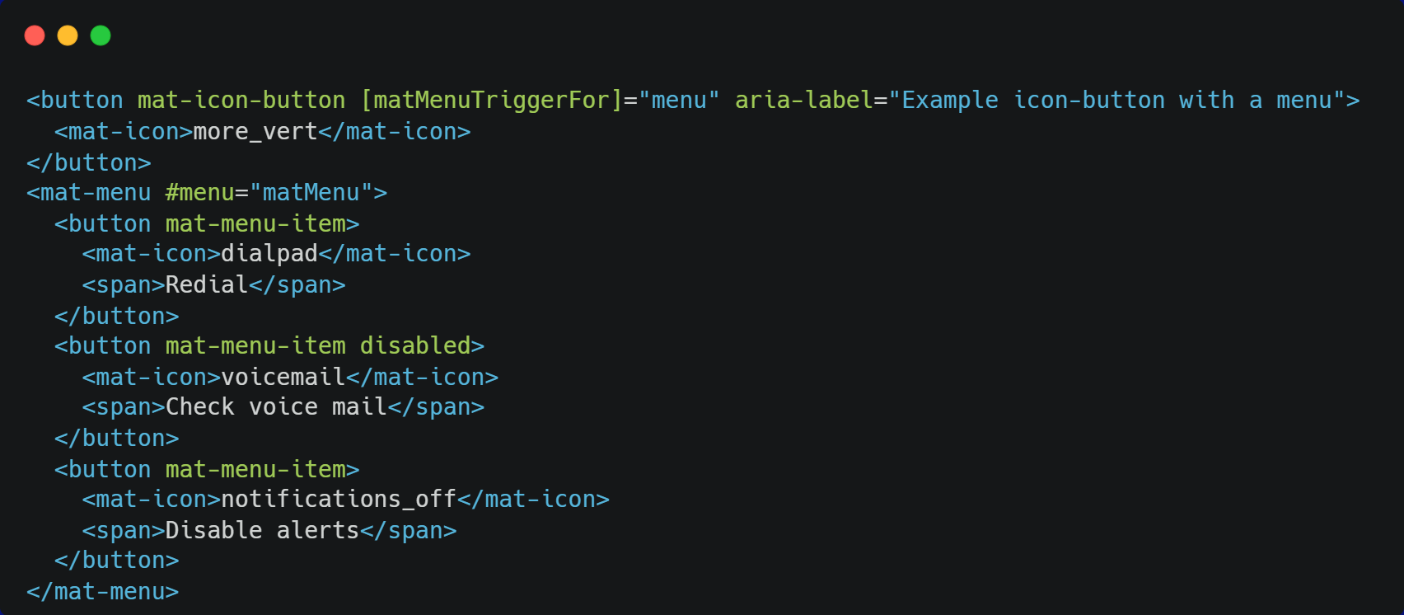
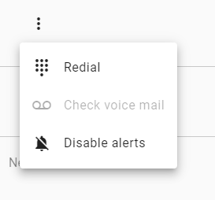
MATERIAL MENU

Slide 70


Navigating between different views of an Angular application
WHAT IS ROUTING?
Achieved using the RouterModule from “@angular/router”
MENTORING IN CONFIDENCE
70

Slide 71



Route: defines the path and the component which will be rendered when the path is accessed.
Router outlet: where are we rendering the content?
ROUTING TERMINOLOGY
Router link: navigation links in templates
Dynamic route parameters: capture values and make them available to the component
MENTORING IN CONFIDENCE
71

Slide 72
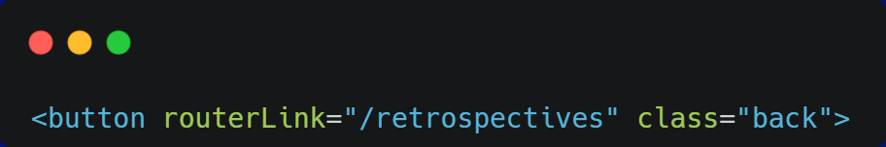


ANGULAR ROUTING

Slide 73


Eager loading
All modules are loaded when the application starts
Default behavior in Angular
LOADING ANGULAR MODULES
Lazy loading
Asynchronous
The modules are loaded when they are needed
The loading of a module can be triggered by user actions, such as navigating to a new route
MENTORING IN CONFIDENCE
73

Slide 74



Achieved by setting up the routes in the App routing module
SETTING UP LAZY LOADING
“loadChildren()” specifies the path to the lazy loaded module
“import()” dynamically imports the module
MENTORING IN CONFIDENCE
74

Slide 75


SETTING UP LAZY LOADING
app-routing.module.ts
Child module

Slide 76


Control whether a user can navigate to (or from) a particular route
ROUTE GUARDS
MENTORING IN CONFIDENCE
76

Slide 77


Handles navigation to routes that don’t exist
WILDCARD ROUTE
MENTORING IN CONFIDENCE
77

Slide 78


Reactive extensions library for Javascript
WHAT IS RxJS?
Reactive programming: paradigm focused on data streams and the propagation of changes
MENTORING IN CONFIDENCE
78

Slide 79




Observable:
Stream of data
Can emit one or more values over time
Can be subscribed to
RxJS KEY CONCEPTS
Observers: subscribe to the observable
Operators: methods that allow you to transform and combine the data emitted by the observables
Subject: cast a value to multiple observers
MENTORING IN CONFIDENCE
79

Slide 80


Slide 81


Slide 82
Containers provide a way to run isolated systems on a single host Operating System
Each container shares the host OS kernel and, usually, the binaries and libraries, too
CONTAINERS

Slide 83
Containers are exceptionally “light” ➡ containers are only megabytes in size and take just seconds to start, versus minutes for a VM
Containers are “shareable” and accelerate development and test by quickly packaging applications along with their dependencies
Containers reduce management overhead. Because they share a common operating system, only a single operating system needs care and feeding (bug fixes, patches, etc)
BENEFITS

Slide 84
A container running with a guest operating system differs from the host OS because of the shared kernel – a Windows container cannot sit on a Linux-based host.
Since containers share the same kernel, host operating systems require special care to avoid security issues from adjacent containers.
Solutions such as Docker make container management easier, but many customers still find container management more of an art than a science.
CHALLENGES

Slide 85



DOCKER
WRAP
Docker containers wrap up a piece of software in a complete filesystem
FILESYSTEM
Code, runtime, system tools, system libraries, anything that can be installed on server
CONSISTENCY
This guarantees that it will always run the same, regardless of the environment it is running in

Slide 87
THANK YOU!

